Slide 1
Image Compression Using
K-Means Clustering
Dhruv Parmar and Wyatt Bowen

Slide 2

What is Image Compression?
Main Goal
File size reduction
How is it achieved?
Color reduction
Resolution reduction
Example
Original on the left
Compressed on the right

Slide 3
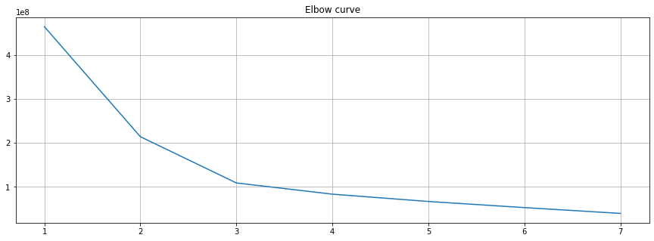

Slide 4
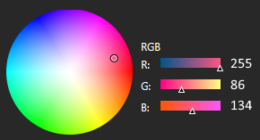
How does K-Means work with Color Reduction?
K = the number of colors left after compression
Pixels have RGB values
Three integer values that exist in a 3D space
Represents a color
255, 255, 255 = White
RGB

Slide 5
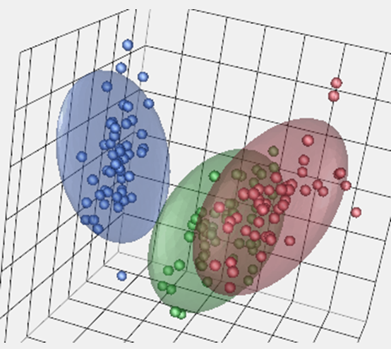
How does K-Means work with Color Reduction?
This an example when K = 3

Slide 6
Images Have Many Pixels
A 1,000 x 1,000 image has 1,000,000 pixels
Find the best k
Create k clusters
Recenter clusters up to 300 times
Record the intra-cluster variation
Change every pixel’s color to its cluster center’s value
Reduces the number of colors
Ultimately, reduces the file size

Slide 7
How to Reduce Number of Comparisons
We run K-Means on only 10% of pixels
Find the best k
Change every pixel’s color to its cluster center’s value
Most pixels do not have a cluster center
We map every pixel’s RGB value to the closest cluster center

Slide 8
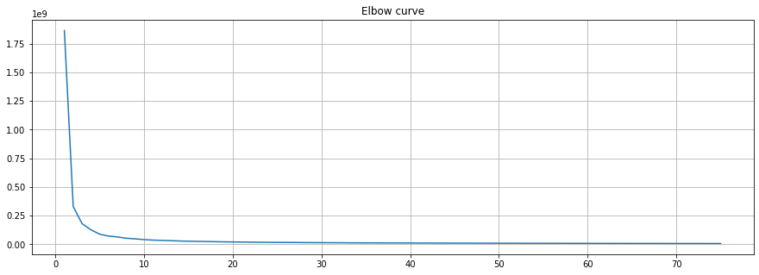
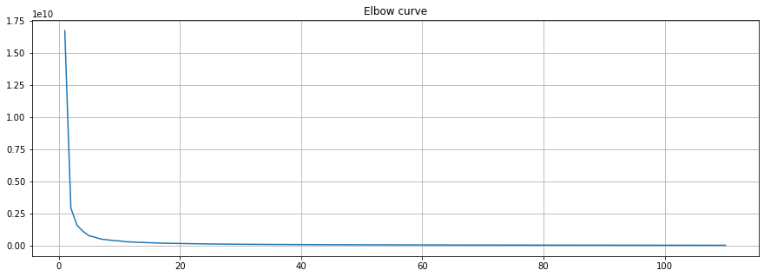
Which Method is Faster?
For a 1024 x 1024 image…
Running K-Means on 10% of the image takes 1 minute and 10 seconds.
Running K-Means on 100% of the image takes 21 minutes and 15 seconds.

Slide 9
Question 1:
Why did we choose to sample 10% of the pixels to run K-means on?

Slide 10
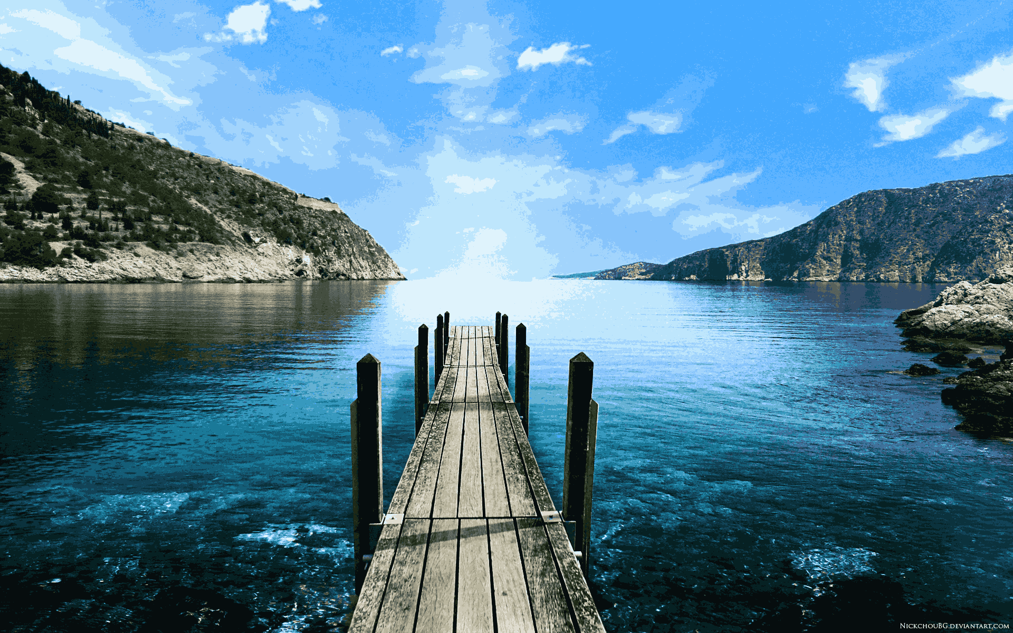

Choosing the Optimal K Value
We do not want to choose the elbow point
(variation in the i th iteration) / (variation in the (i-1)th iteration) ≥ 0.995
0.98 0.995

Slide 11
Question 2:
Why did we not select the elbow point on the elbow graph?

Slide 12
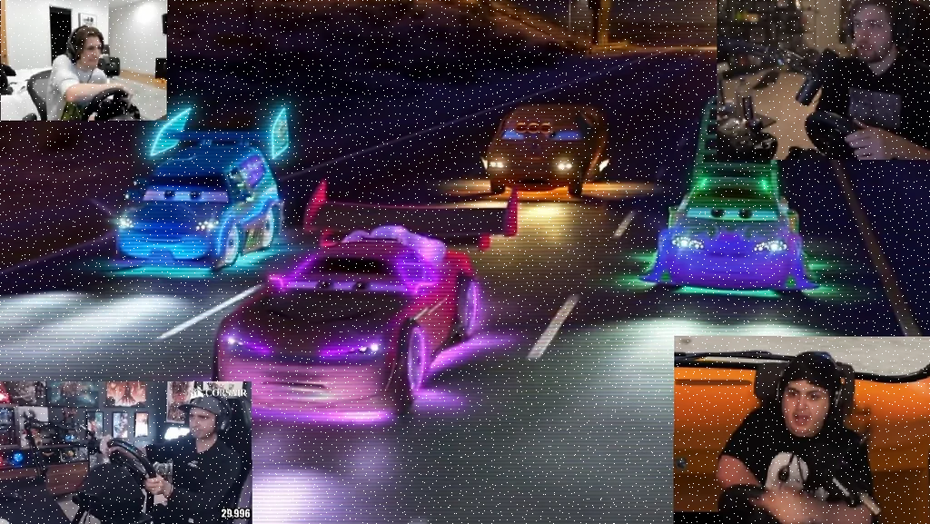
Sampling the Pixels
Goals
Sample pixels evenly around the image
Avoid sampling collinear pixels
Achieved by
Systematic random sampling
Random offsets of the selected indices

Slide 13
How to predict with K-Means?
K-Means is only run on 10% of pixels
Every pixel determines which cluster center it’s closest to
Euclidean distance

Slide 14
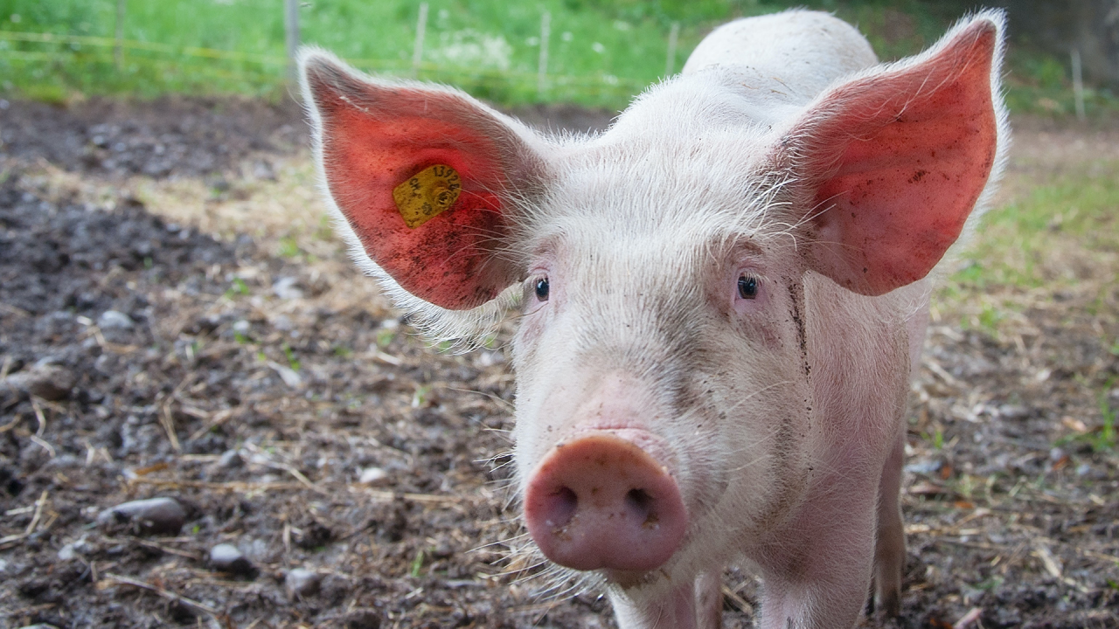

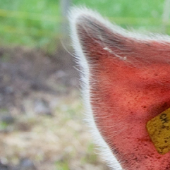
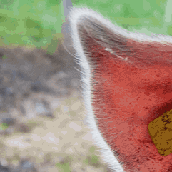
Original Compressed
1.68 MB
0.957 MB

Slide 15
Question 3:
What is the compressed file size divided by the uncompressed file size?
(Ratio or percentage)

Slide 16
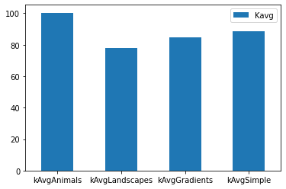
Types of Images
Types:
Animals
Landscapes
Gradients
Simple
Why?
To ensure the performance for different types of images
Compare average optimal K values for different types of images

Slide 17
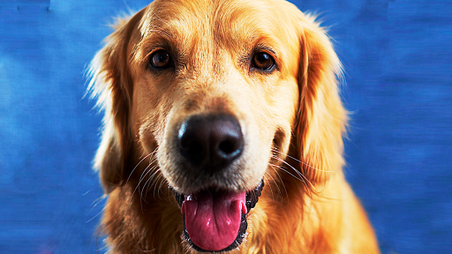
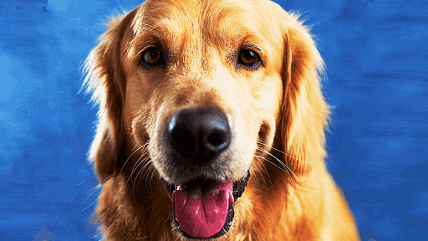
Thank you!
297 KB 134 KB

